Slide 1
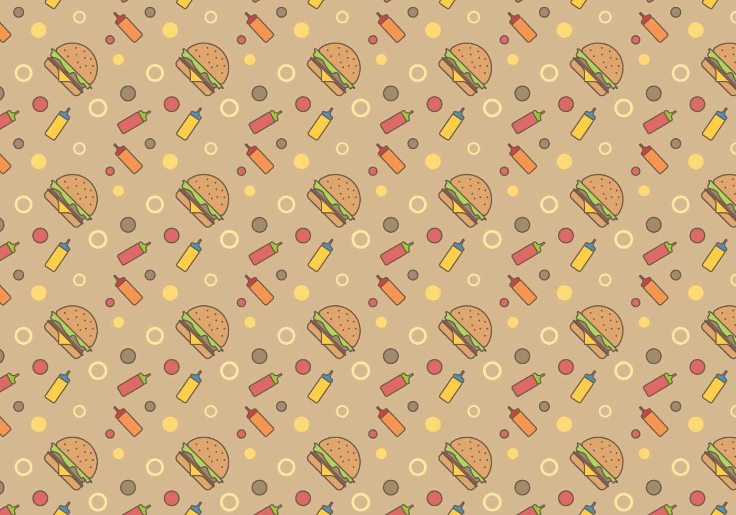
FAST FOOD
Timofey Sinyaskiy 10-I form

Slide 2
HISTORY

Slide 3
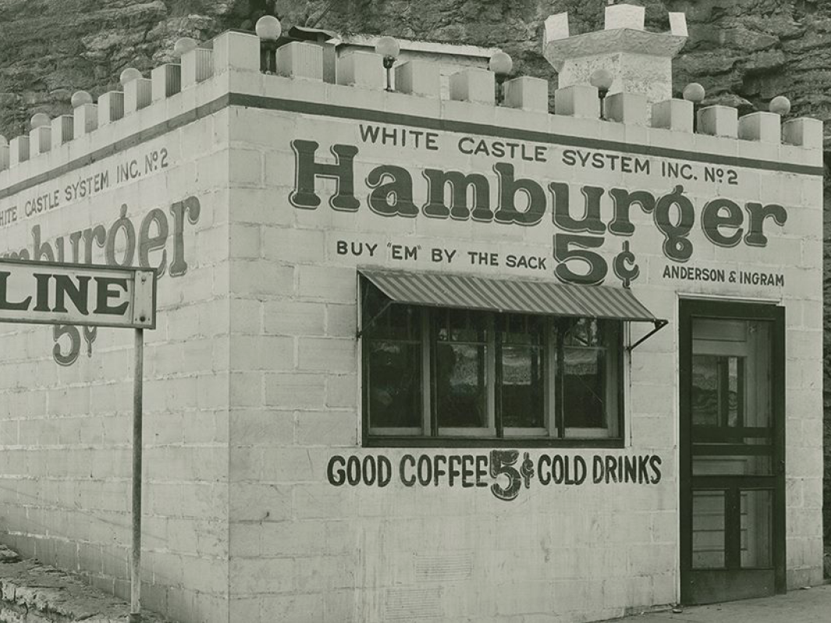
White Castle
1921, Wichita, Kansas, USA
There is one of first eatery, but not first maybe

Slide 4
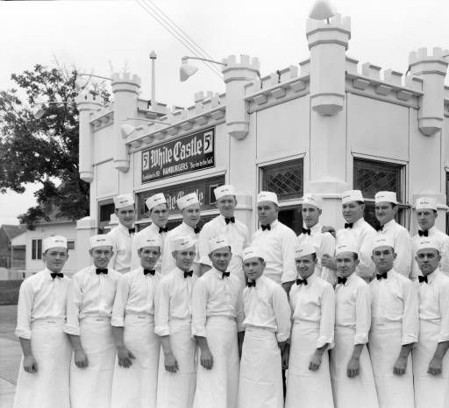
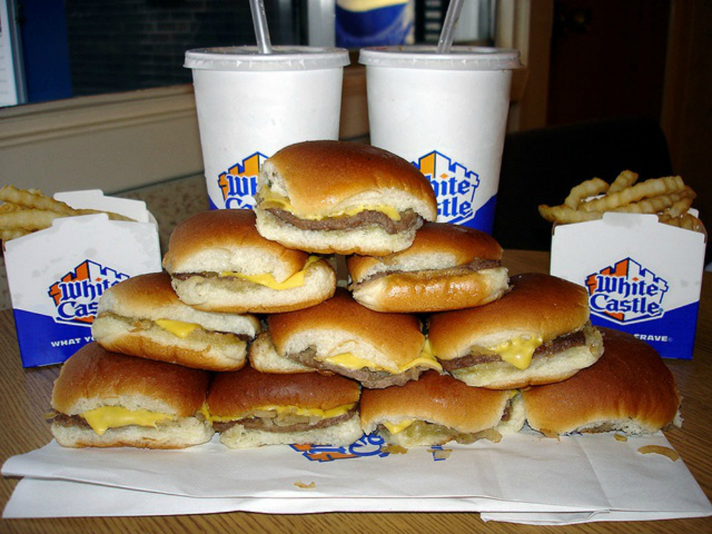
Trick

Slide 5
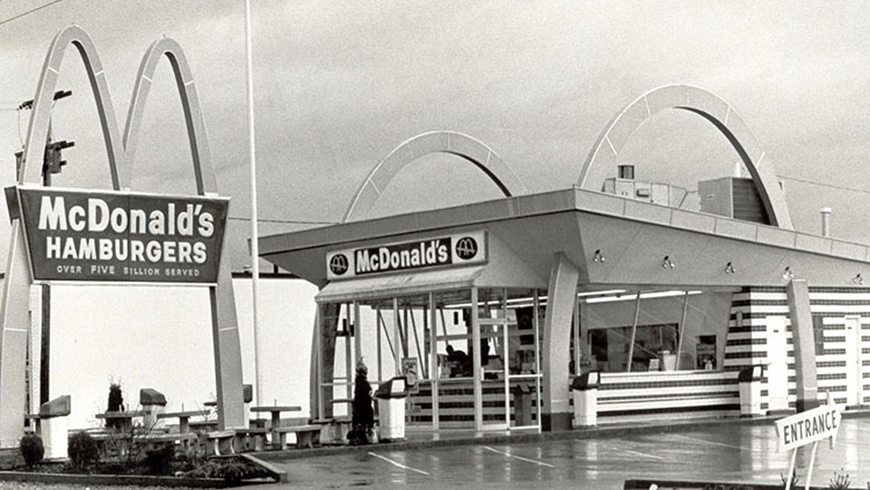
Opponent
Number of restaurants
1960 | 228
1968 | 1000
1975 | 3076
1980 | 6263
1984 | 8300
1990 | 11800
now | More than 30k

Slide 6
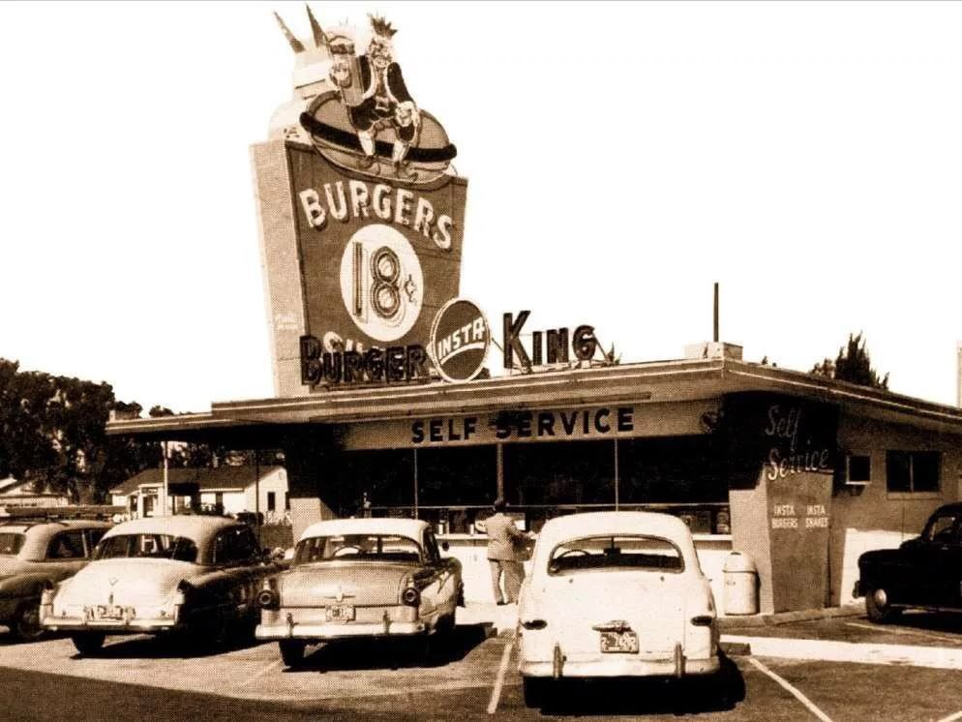
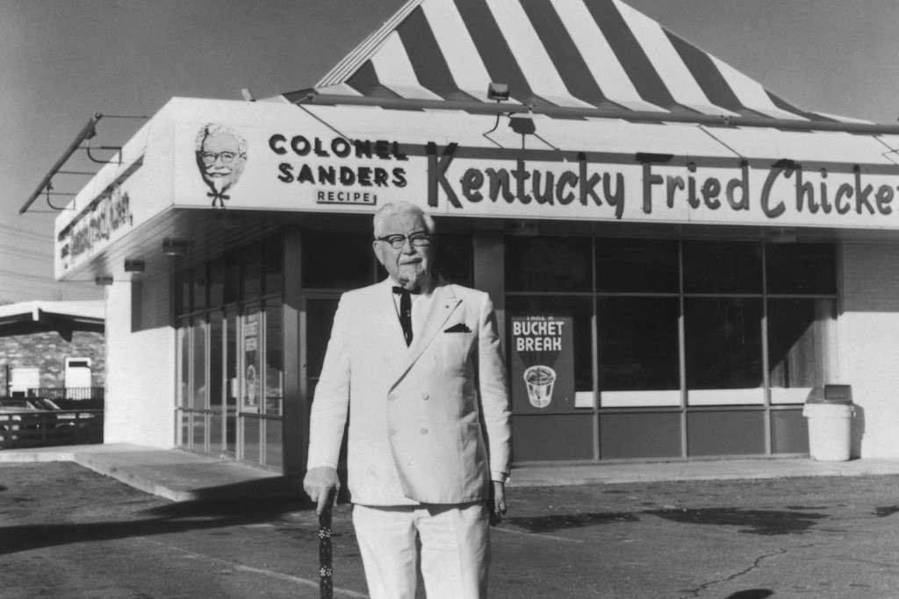
Other fast food companies

Slide 7
Nowadays

Slide 8
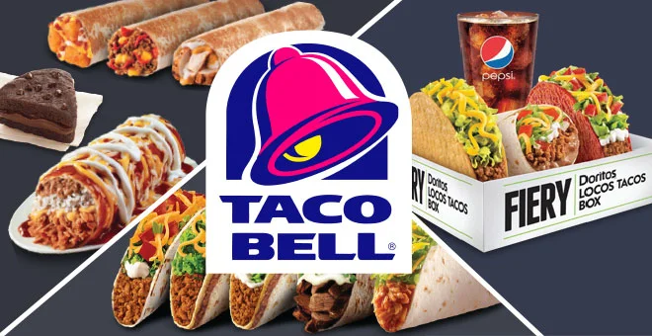
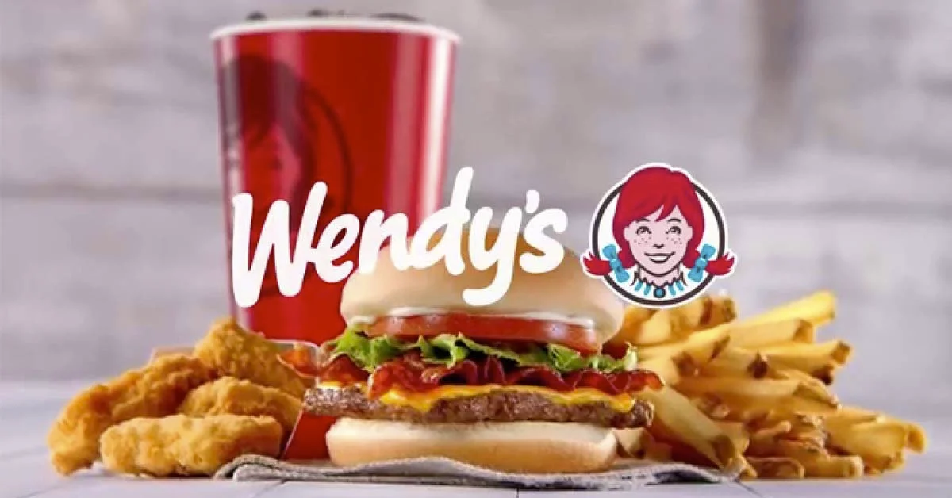
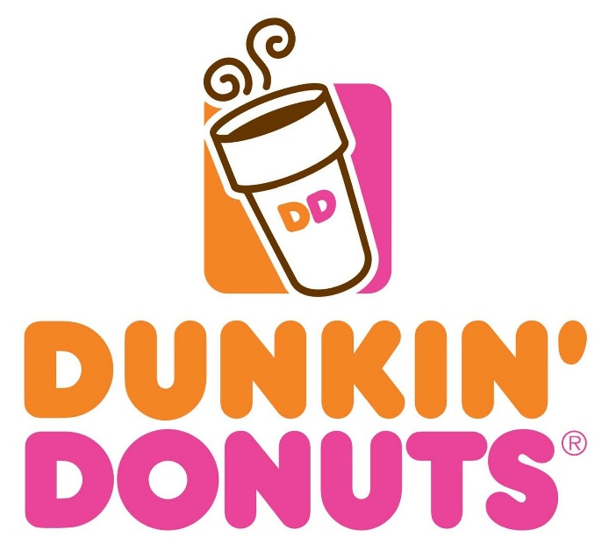
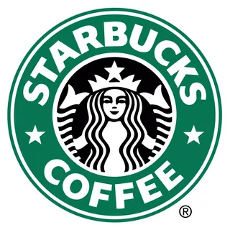


Slide 9
THANK YOU FOR YOUR ATTENTION!

